Slide 1


Jay Anderson

Slide 2



Jay Anderson
(continued)
4.5th Year Senior
Major: Computer Science
Minor: Pre-Law
Interests: GT Rugby, Claymore, Hip Hop, Trance, Drum and Bass, Snowboarding etc.

Slide 3
CURE
An Efficient Clustering Algorithm for Large Databases
Sudipto Guha Rajeev Rastogi Kyuseok Shim
presented by Jay Anderson

Slide 4
Agenda
What is clustering?
Traditional Algorithms
  Centroid Approach
  All-Points Approach
CURE
Conclusion
Q&A

Slide 5
What is Clustering?
Clustering is the classification of objects into different groups.
Clustering algorithms are typically hierarchical
  Think iterative, divide and conquer
or partitional
  Think function optimization

Slide 6
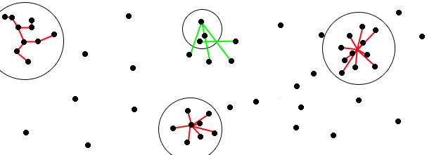
Traditional Algorithms
All-Points Based
d_{min,} d_{max}
Centroid Based
d_{avg}, d_{mean}

Slide 7
The All-Points Approach
Any point in the cluster is representative of the cluster.
d_{min}(C_{a}, C_{b}) = minimum( || p_{a,i} – p_{b,j} || )
d_{max}(C_{a}, C_{b}) = maximum( || p_{a,i} – p_{b,j} || )
d_{min} represents the minimum distance between two points of a pair of clusters. It’s counterpart, d_{max} works similarly for divisive algorithms in that the pair of points furthest away from each determines who gets voted off the island.

Slide 8
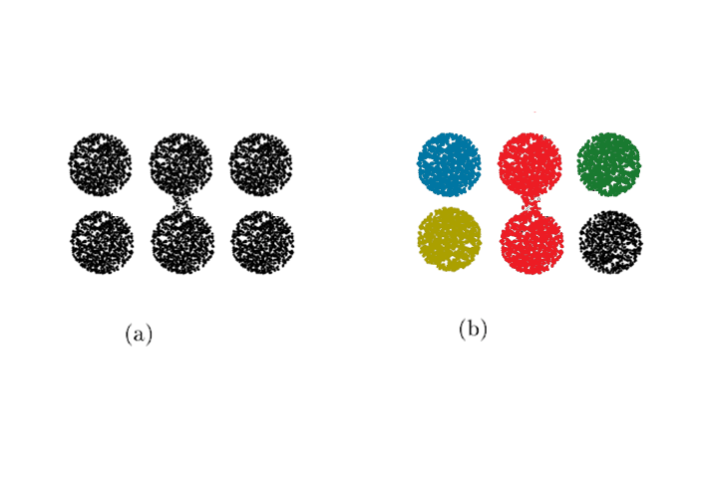
The All-Points Example
Any point in the cluster is representative of the cluster.

Slide 9
The Centroid Approach
Clusters as represented by a single point.
d_{mean}(C_{a}, C_{b}) = || m_{a} – m_{b} ||
d_{avg}(C_{a}, C_{b}) = (1/n_{a}*n_{b}) * Σ[a] Σ[b] || p_{a} – p_{b} ||
These distance formulas find a centroid for each cluster. In identifying a central point, these algorithms prevent the ‘chaining’ by effectively creating a radius for possible clustering from the chosen point.

Slide 10
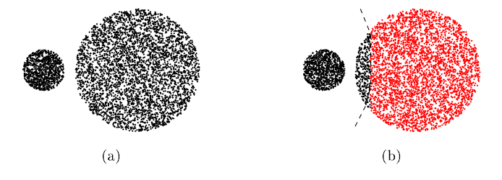
The Centroid Example
Clusters as represented by a single point.

Slide 11
Disadvantages
Hierarchical models are typically fast and efficient. As a result they are also popular.
However there are some disadvantages.
Traditional clustering algorithms favor clusters approximating spherical shapes, similar sizes and are poor at handling outliers.

Slide 12
CURE
Attempts to eliminate the disadvantages of the centroid approach and all-points approaches by presenting a hybrid of the two.
1) Identifies a set of well scattered points, representative of a potential cluster’s shape.
2) Scales/shrinks the set by a factor α to form (semi-centroids).
3) Merges semi-centroids at each iteration

Slide 13




CURE
(continued)
Choosing well ‘scattered points’ representative of the cluster’s shape allows more precision than a standard spheroid radius.
α
Shrinking the sets, increases the distance from each cluster to any outlier, possibly the distance beyond the threshold and, mitigating the ‘chaining’ effect.

Slide 14
CURE
(Continued)
Time Complexity: O(n² log n)
  O(n2) for low dimensionality
Space Complexity O(n)
  Heap and tree structures require linear space

Slide 15
Q+A

